Slide 1
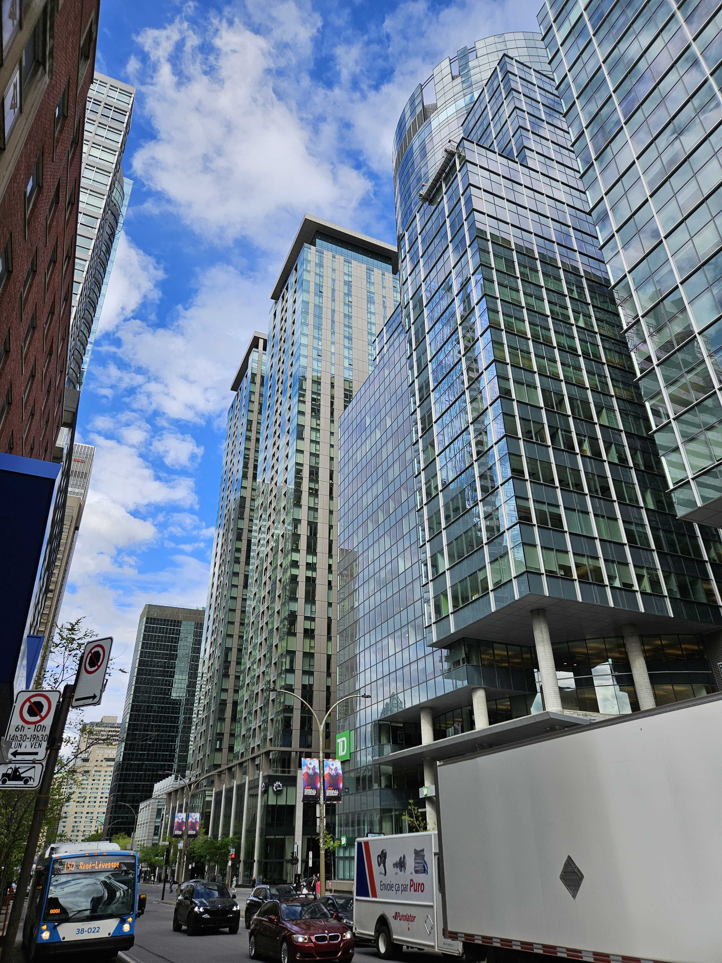
CanBuildAI: Accelerating the Design and Retrofit of Affordable, High-Performance Buildings
Designing and retrofitting high performing buildings at the same or lower cost than code compliant ones

Slide 2
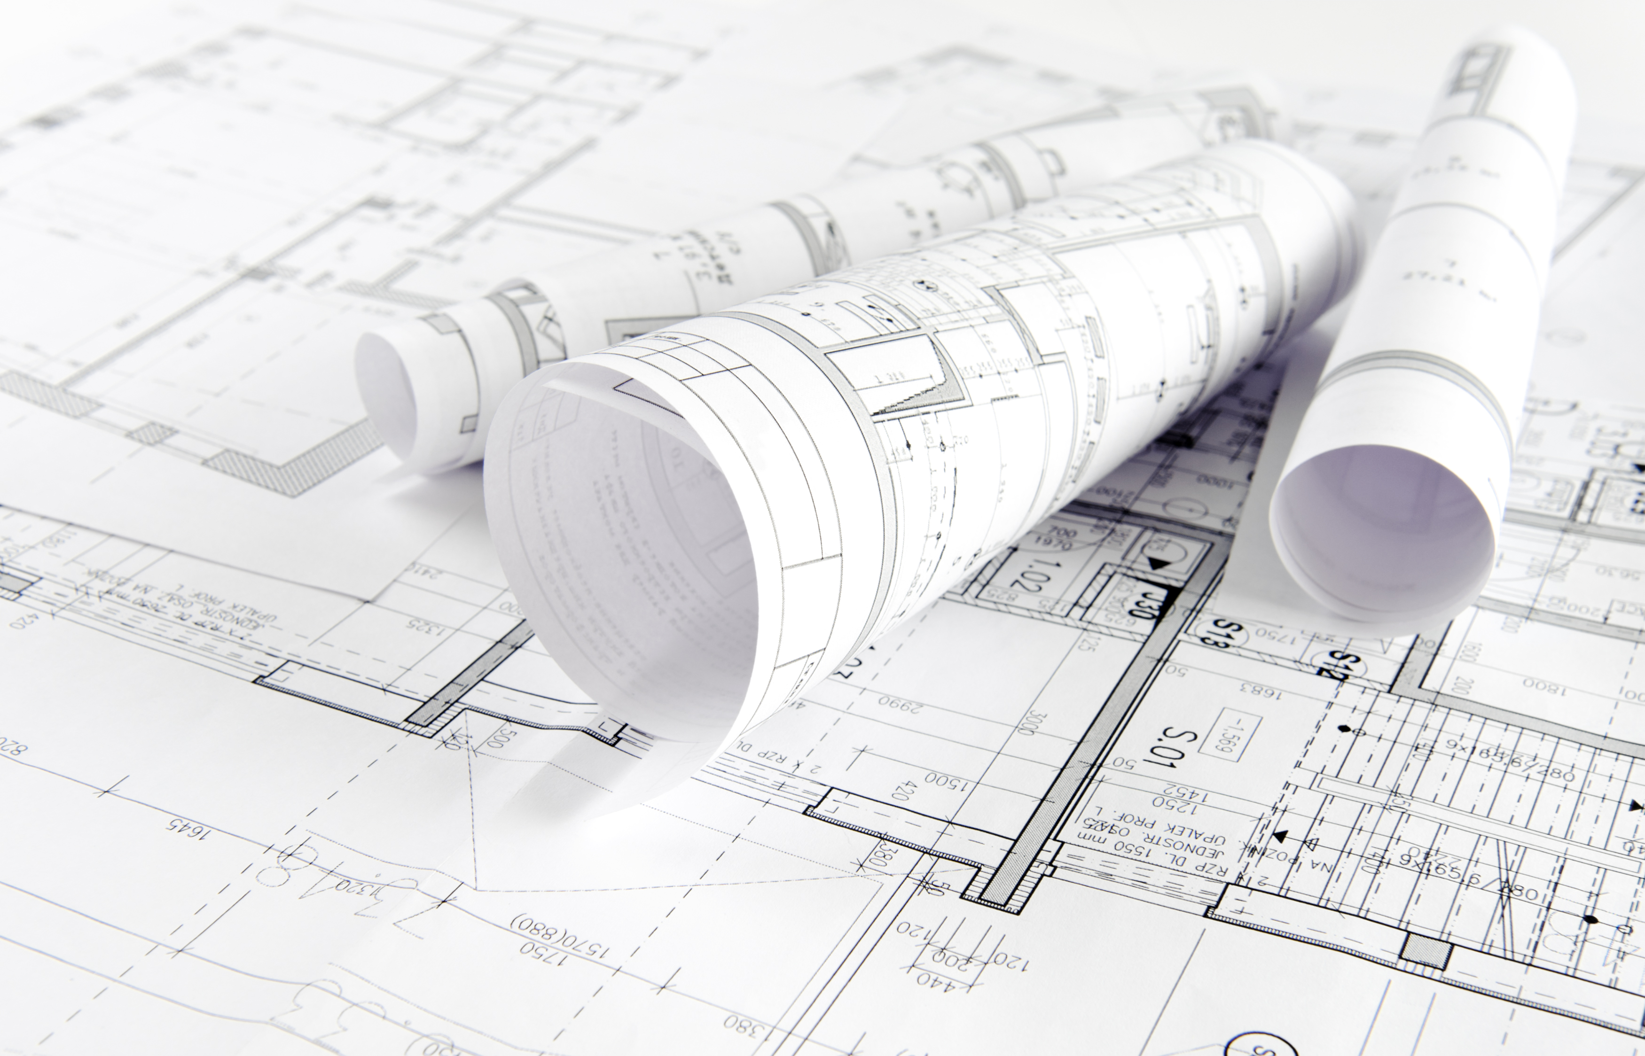
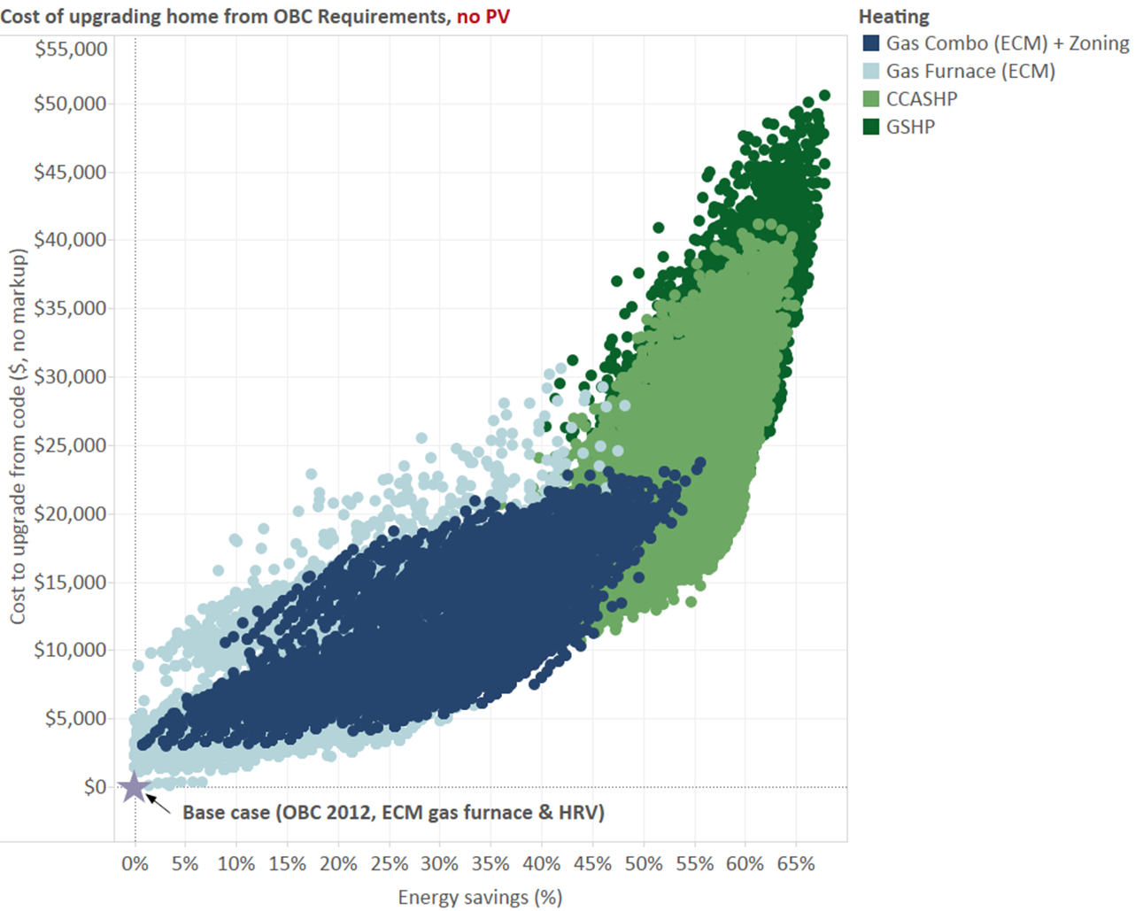
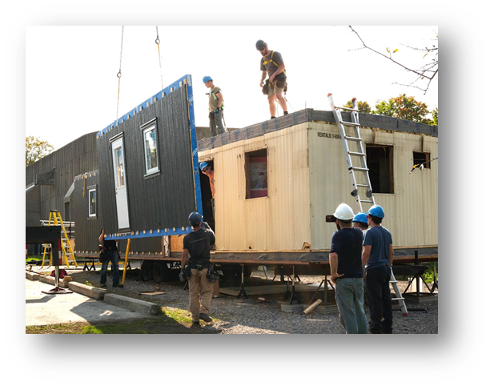
H&B Research Activities
We
Building Envelope Research
Investigate and characterize nascent, carbon-storing materials
factory-built building envelope assemblies and construction systems
Minimize carbon, cost, and waste
Maximize performance, affordability, durability and quality
Simulation and Data Analytics for Housing and Building Stock
Development of energy (+carbon) codes
Support other federal government departments, utilities and provincial governments and identify cost-effective program design to reduce energy and carbon in the built environment
H&B Software framework to optimize cost and carbon for:​
New residential and non-residential buildings​
Retrofits of existing residential and non-residential buildings

Slide 3
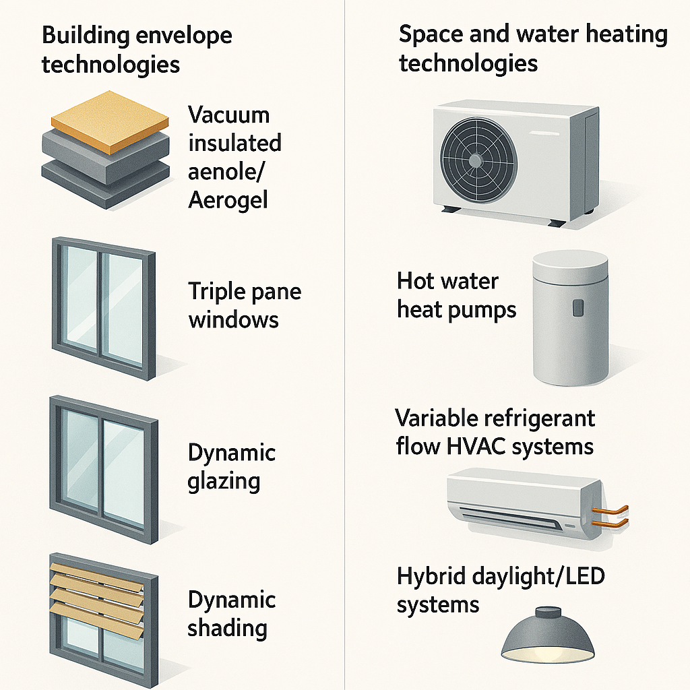
High performing technologies
are necessary
but not sufficient
to meet
building cost and performance goals

Slide 4
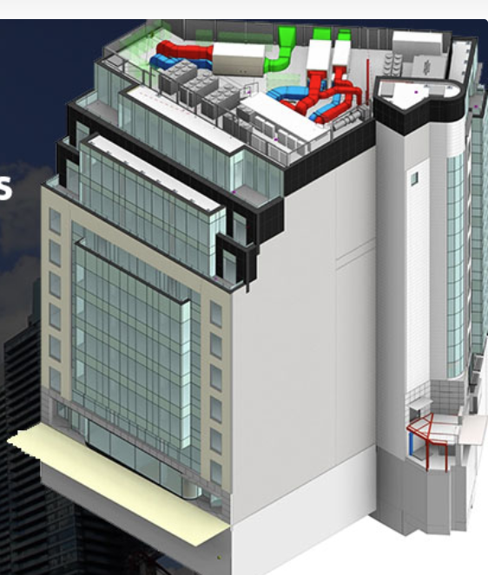
We
Buildings are “more” than the sum of their parts
High performance curtain wall system
Efficient mechanical systems
Highly insulated wall system
High-performing technologies must be properly chosen, sized, and operated to deliver their full potential.
The design of most buildings falls short.

Slide 5
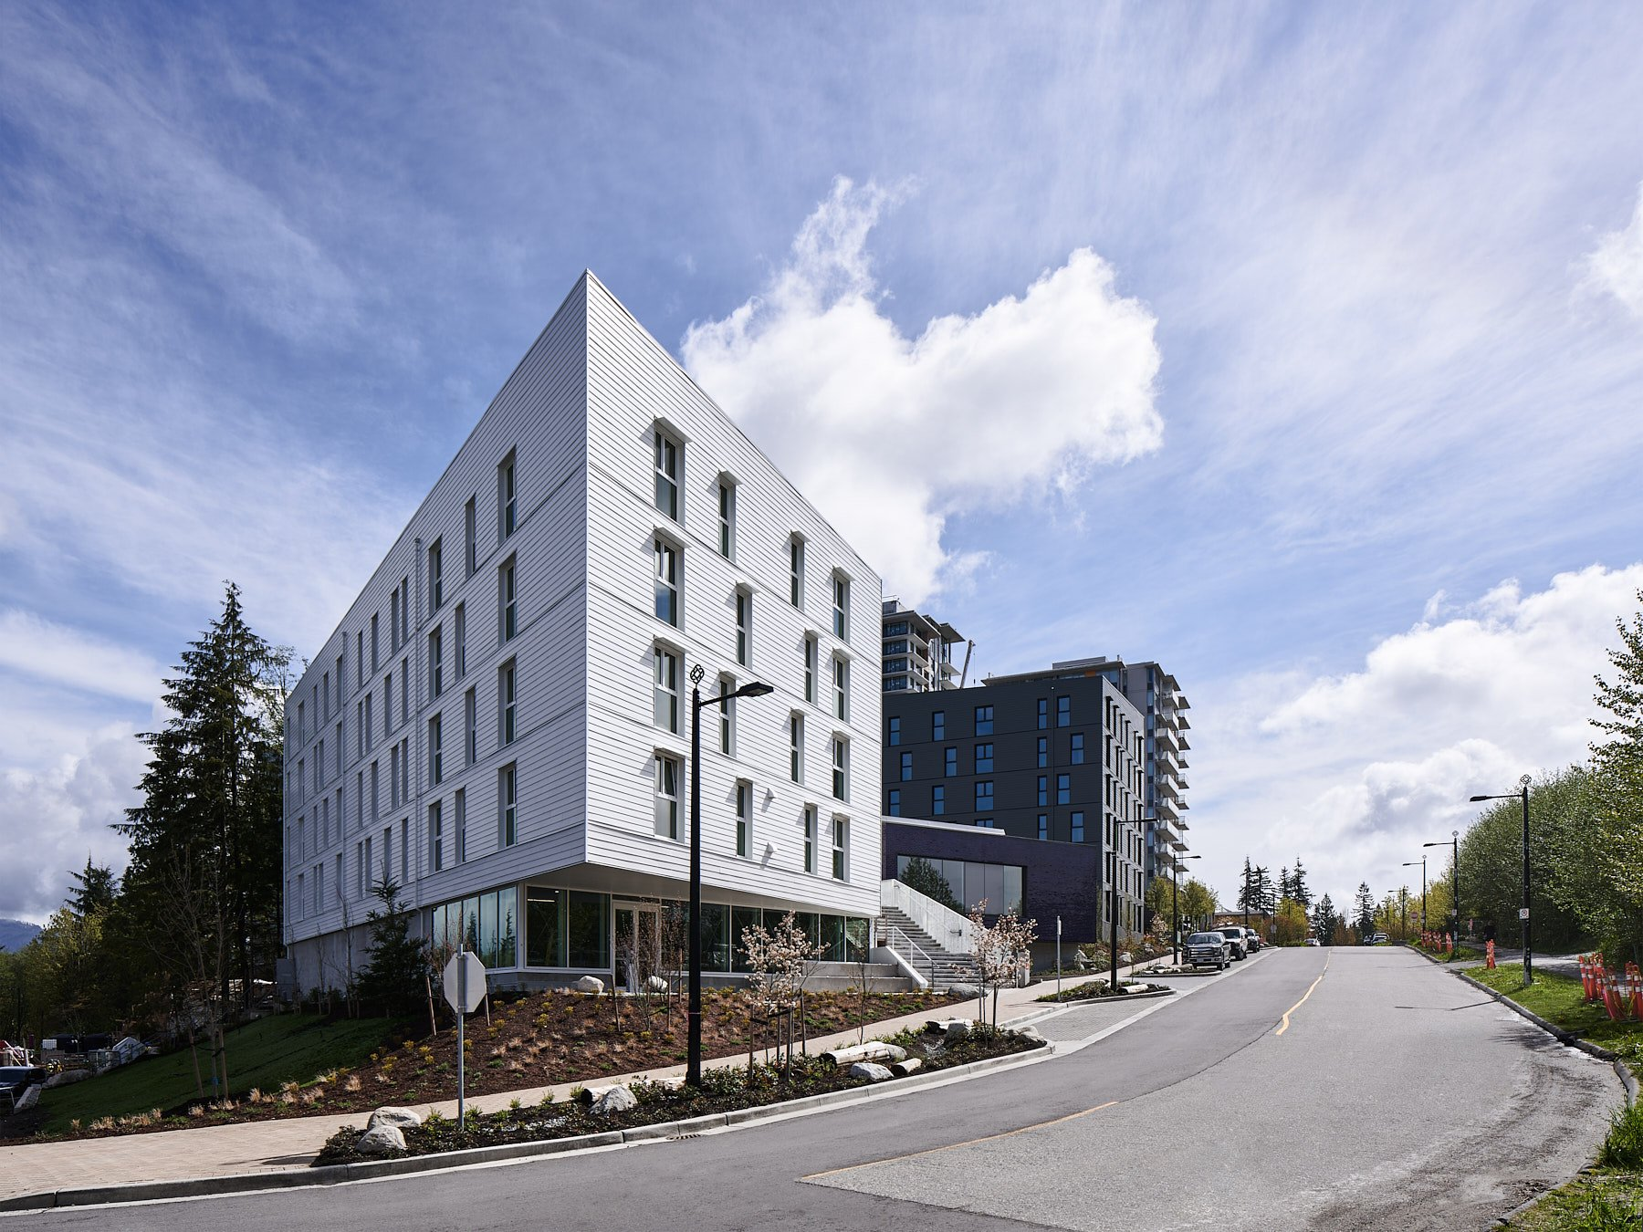
SFU Affordable Housing
Built in 2022
High-performance at a no-cost premium
Characteristics
Passive cooling through shading
Efficient envelope
Simple building forms
Smaller HVAC
Holistic
Why are not ALL buildings designed to be affordable and high performing like the SFU Affordable Housing?

Slide 6
Barriers to High-Performance Buildings
Services often awarded to the lowest bidder
Evaluating design options takes time
Designers reuse familiar but suboptimal designs to avoid risk and delays
Holistic design is avoided by most projects as it takes skill and time to look at options

Slide 7
We
We need to
minimize
the time required to
select and evaluate the options!

Slide 8
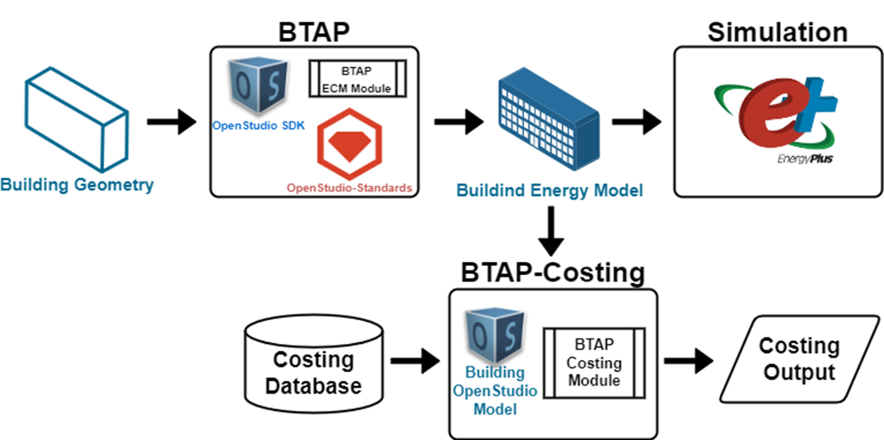
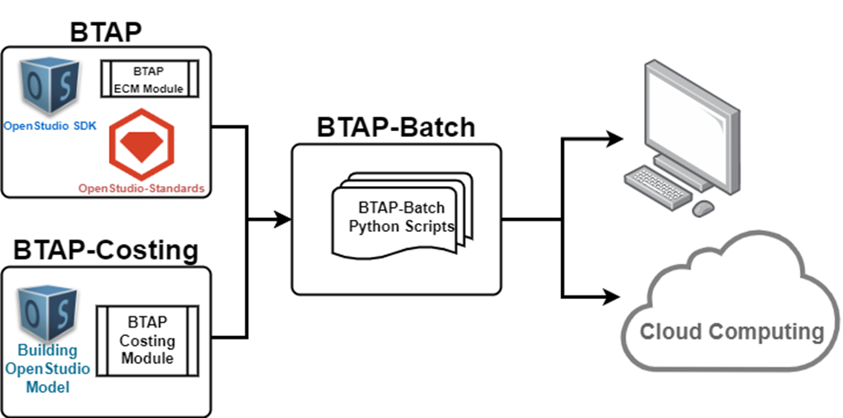

We
First generation solution
Was fast for its time, but we can do better.
Building Archetypes

Slide 9
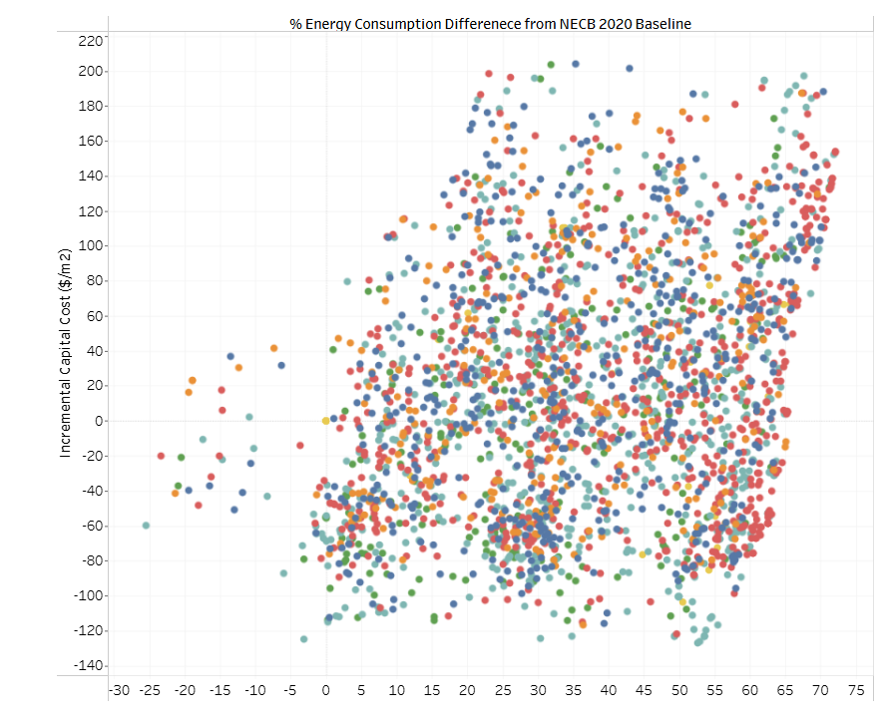
We
Energy Consumption Difference from NECB 2020 Baseline (%)
Solutions that cost more and perform better
Incremental Capital Cost ($/m²)
Solutions that cost less and perform better
Code compliant solution
Building Archetypes

Slide 10



We
Challenges of first generation solutions
Results not general
Results are for specific characteristics, and not general in nature and of limited use
Brittle results
Information
Rich info content
Need for Detailed Building Characteristics
Results not easily interpreted
Interpretation of simulation results challenging and not amenable to querrying
Comprehensive information, including architectural plans, process flow diagrams, and construction details, is required.

Slide 11





We
Next generation solutions
Databases
Large databases of building simulation results
Surrogate models for Fast Access
Fast, intelligent access to data using Machine Learning and Deep Learning models
Large Language Models (LLMs)
Empower non-experts to make informed decisions
AI Simulation Hub
Expand to include other documents
Leverage all accessible internal documents and data to enhance the capabilities of the LLM for accurate, domain-specific responses

Slide 12









We
Workflow – if you absolutely want to know how it would work…
The approach provided results ~10000x faster than conventional simulation.
HTAP/HPXML
Preprocessing
Residential/Commercial Building
Input Features:
Building Type
Envelope Info
HVAC Info
…
Vector Store
Context
Data Chunks
Embedding
X kWh
BTAP
Output
Energy Use
Cost
LLM
Prompt Augmentation
Given this data: - Building Type: Office - Size: 5000 sq ft - HVAC: Centralized, Type ASHP, Window Type Double glazed, with 5 occupants
Question: How much will this building consume per month?
Semantic Search
Based on similar buildings, estimated annual energy use is 8,200 kWh, cost is $1,100
Response
Embedding

Slide 13



We
Prototype Development Workflow
Frontend Development
The frontend will be designed to collect major building features and information from users, save them, and submit them to the backend model.
04
Data Base Creation
Connection of the Frontend and Backend
03
A synthetic database of millions of building designs across Canada
02
The data is then submitted through the developed API to the backend, where the prediction results from the trained ML models are sent back to the users in a very short amount of time.
Model Training/Tuning
01
Training and testing different ML algorithms to develop surrogate models

Slide 14



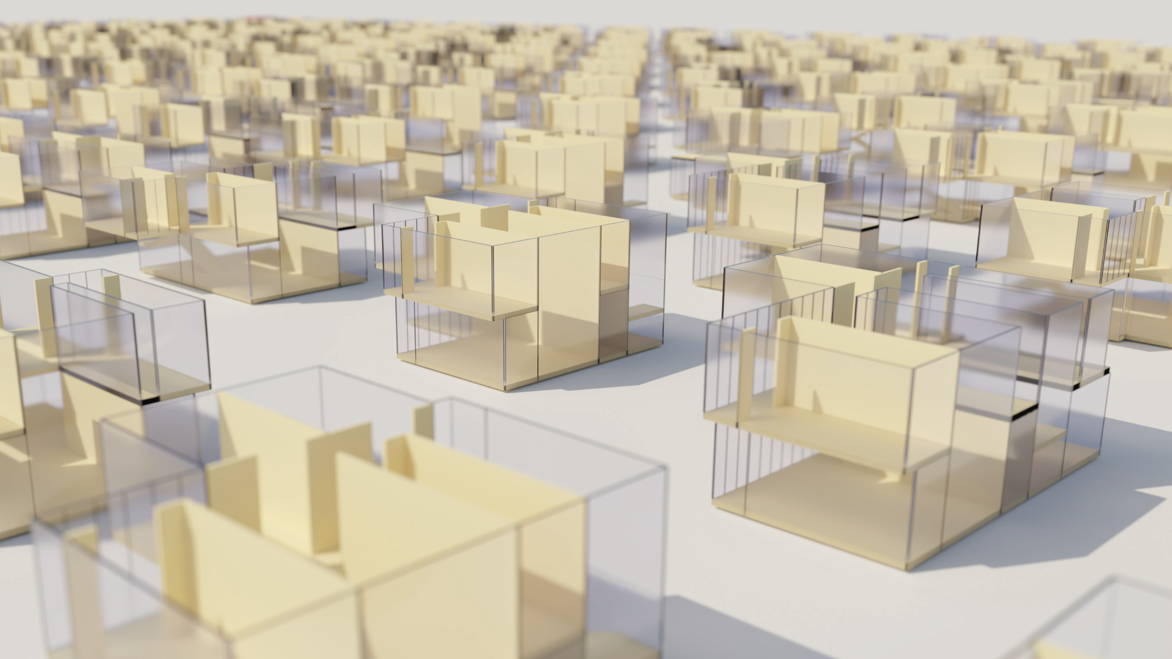


Building Design Process with CanBuildAI
CanBuildAI generates costed options
Designer gathers initial data
CanBuildAI provides range of options
Designer enters data into CanBuildAI
Designer modifies options

Slide 15
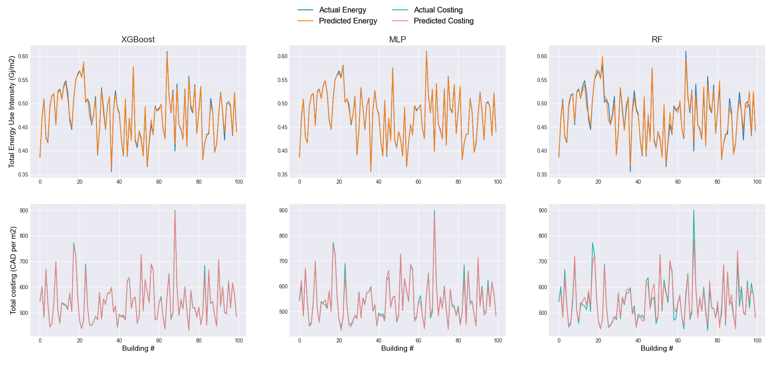
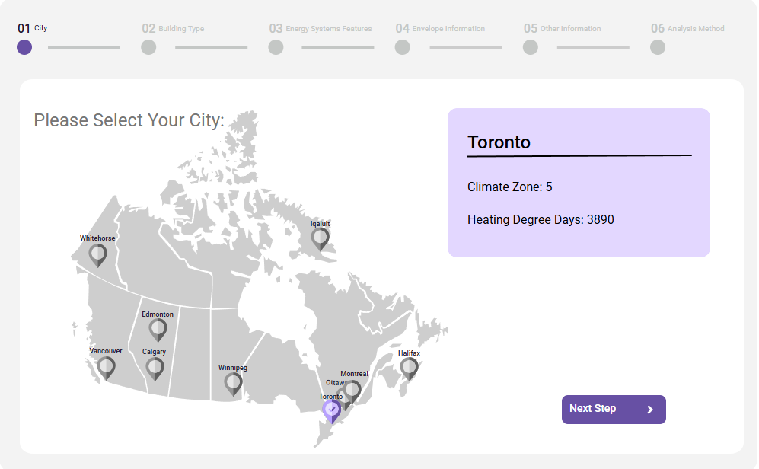
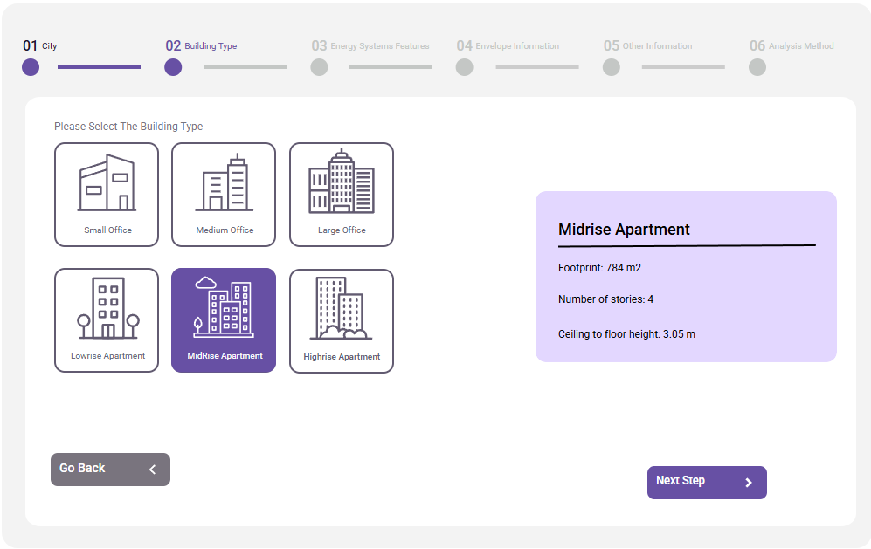
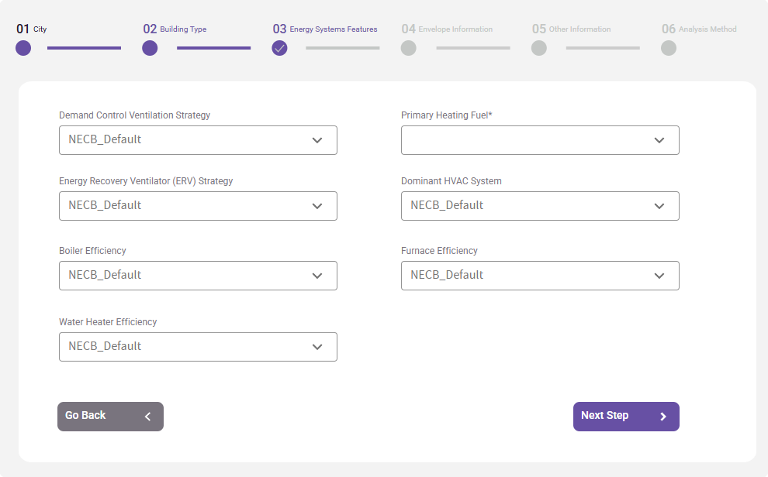
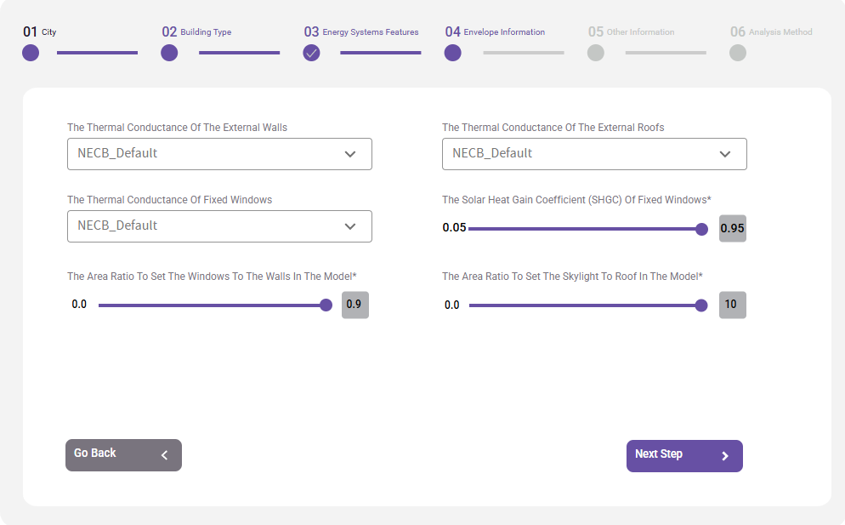
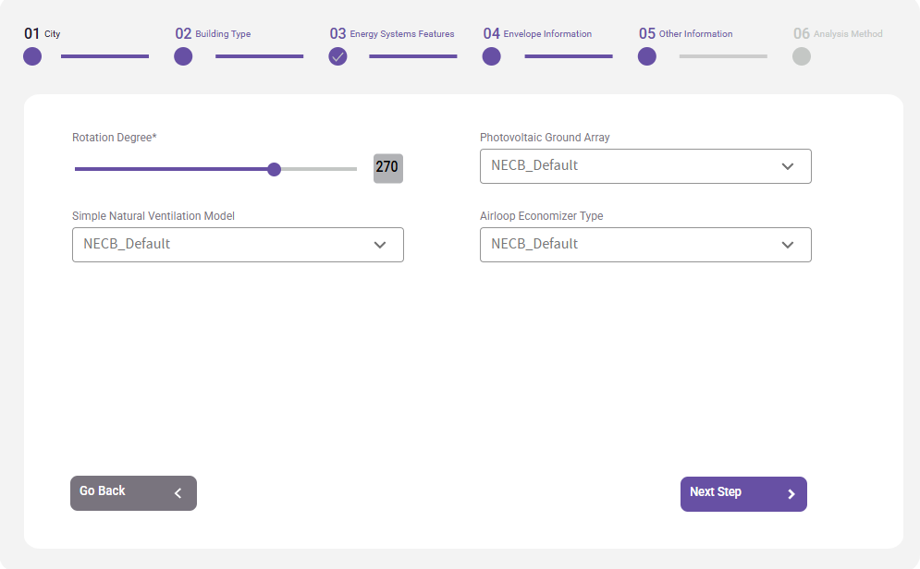
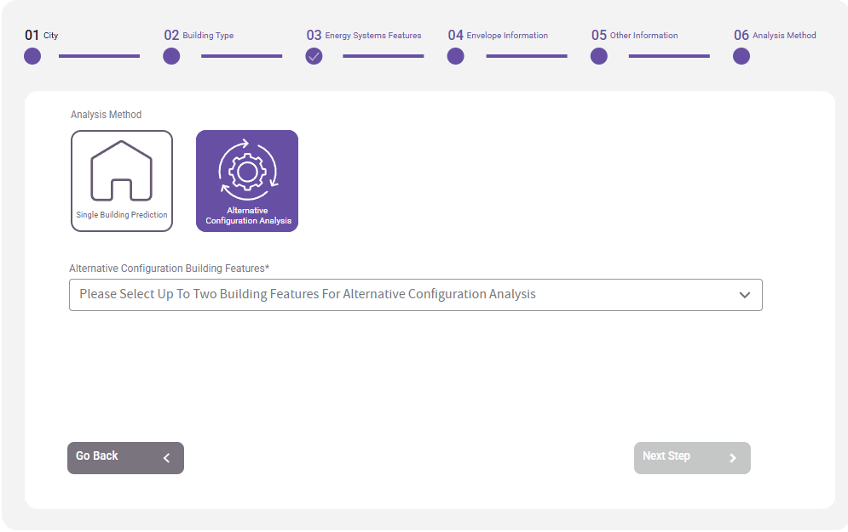
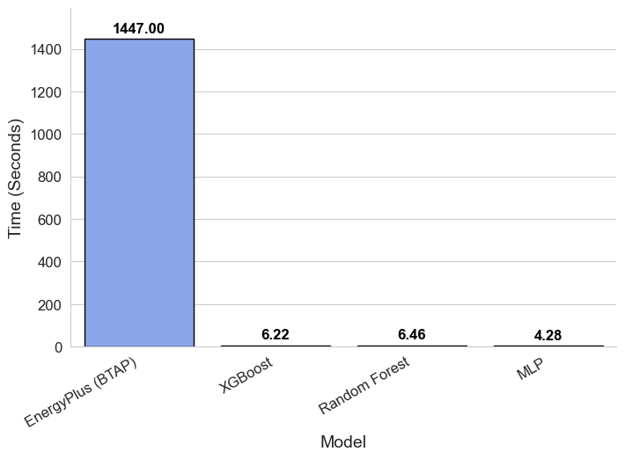
We
Some Initial Results Using Surrogate Models

Slide 16
How do we make life easier for designers to design new and retrofit buildings
The work to date has been at the proof-of-concept / Prototype level
There is still work to be done to:
Surrogate modelling work mostly complete
Expand the current state to develop and validate the methodology
Further develop the interface
Identify host that will be responsible for the maintenance of the CanBuildAI (already talked with CaGBC)

Slide 17

Multi-Agent System Supporting Building Design
User Provides goals, constraints, reviews options
(Geometry, Plain Text)
Designs with KPI
Hourly Energy / Peak
Capital Costs
Carbon
Resilience
CanBuildAI Designer Agent
Orchestrates specialized agents and design loops, and reports back to user.
HVAC Agent
System Sizing, Equip Selection / templates
Envelope Agent
Insulation, Windows, Constructions, air-tightness
Weather Agent
Databases, Average, Future, Extreme
Costing Agent
Utility, Capital, Labour & Carbon Databases
Building Stock Agent
NREL Comstock, EPA PM, SCIEU, Energuide
Analysis Agent
Physics or ML Surrogates
Building Codes Agent
Codes (NBC / NECB/ A90.1)
Renewables
Results and reporting.

Slide 18
Thank-you!
CanmetENERGY-Ottawa’s Housing and Buildings team:
Sara Azimi
Martin Boulay
Sébastien Brideau
Mark Carver
Brock Conley
Alex Ferguson
Sara Gilani
Kamel Haddad
Maria Hachem
Brodie Hobson
General Inquiries: Meli Stylianou (Meli.Stylianou@nrcan-rncan.gc.ca)
Chris Kirney
Phylroy Lopez
Chris McLellan
Nicholas Pneumaticos
Hamish Pope
Julia Purdy
Navid Shirzadi
Ali Syed

